Slide 1
Integrity Constraints
In SQL

Slide 2
Integrity Constraints
Integrity constraints are a set of rules. It is used to maintain the quality of information.
Integrity constraints ensure that the data insertion, updating, and other processes have to be performed in such a way that data integrity is not affected.
Thus, integrity constraint is used to guard against accidental damage to the database.

Slide 3
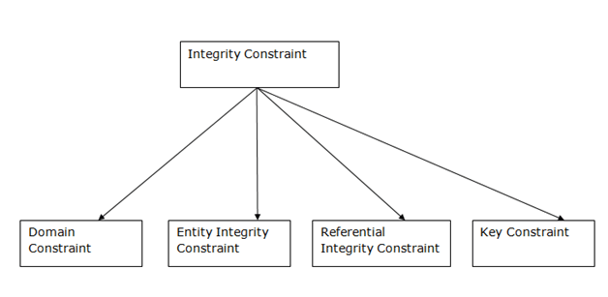
Types of Integrity Constraints

Slide 4
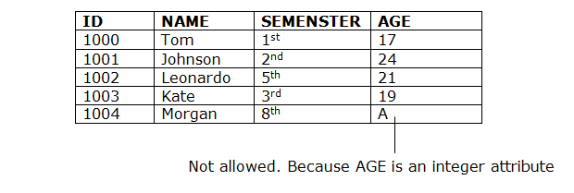
1. Domain constraints
Domain constraints can be defined as the definition of a valid set of values for an attribute.
The data type of domain includes string, character, integer, time, date, currency, etc. The value of the attribute must be available in the corresponding domain.

Slide 5
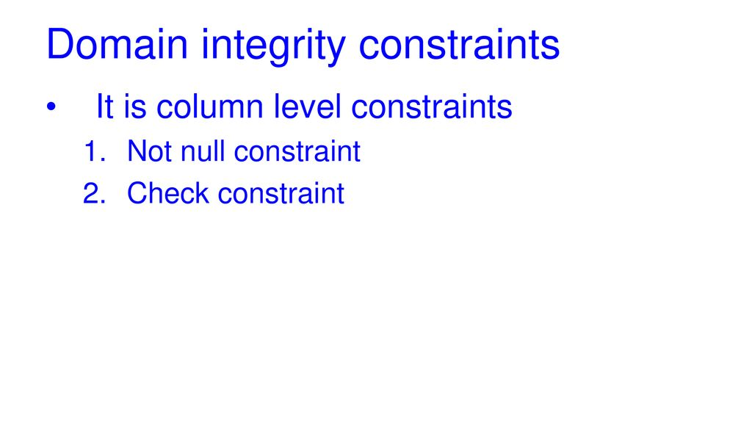

Slide 6
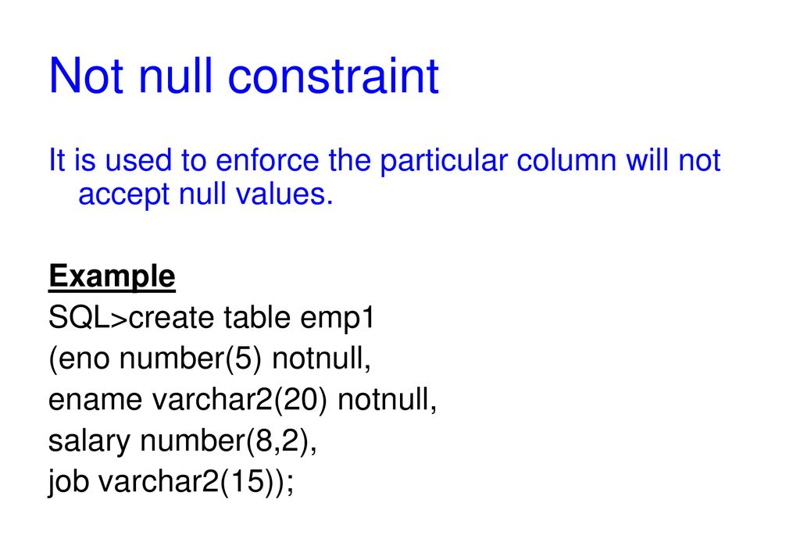

Slide 7
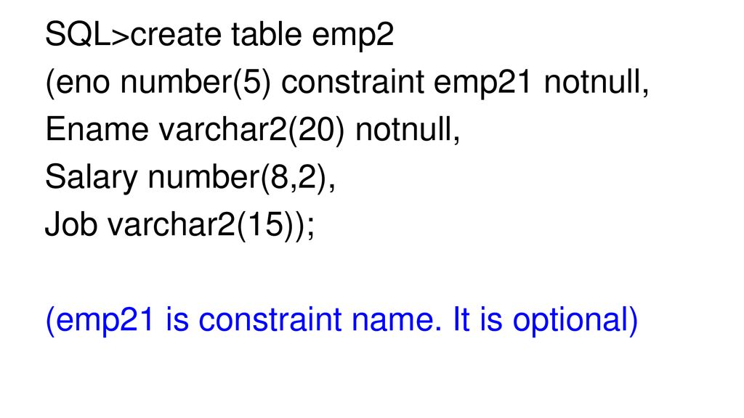

Slide 8
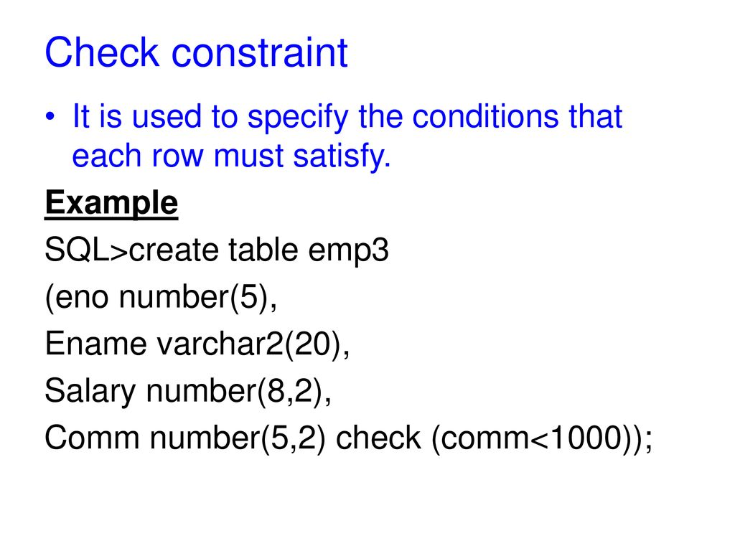

Slide 9
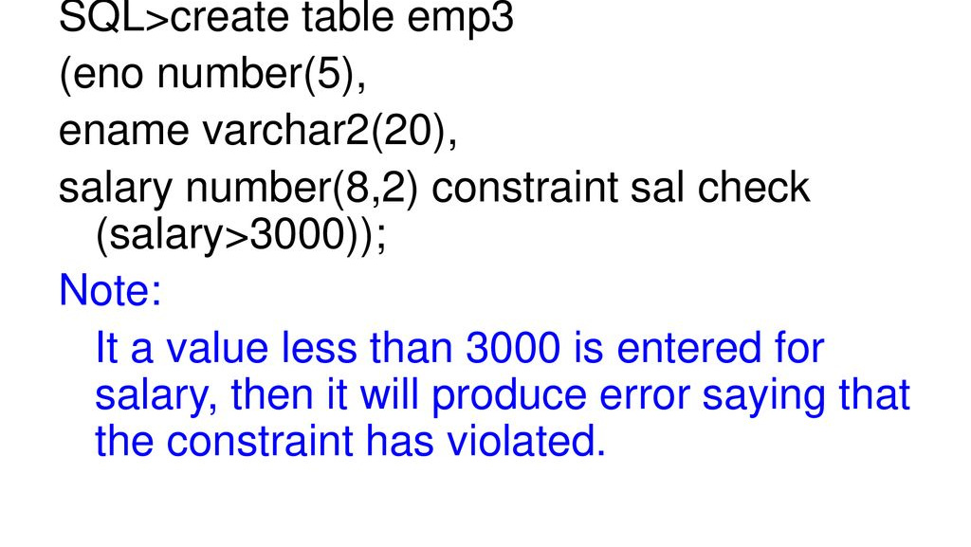

Slide 10
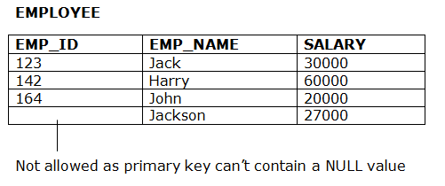
2. Entity integrity constraints
The entity integrity constraint states that primary key value can't be null.
This is because the primary key value is used to identify individual rows in relation and if the primary key has a null value, then we can't identify those rows.
A table can contain a null value other than the primary key field.

Slide 11
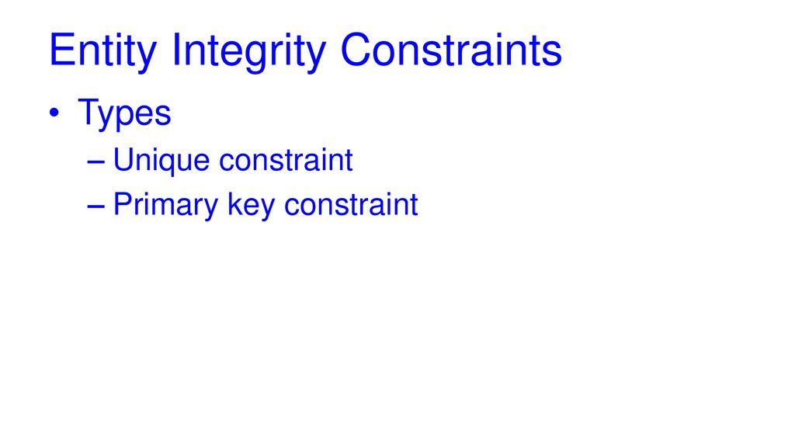

Slide 12
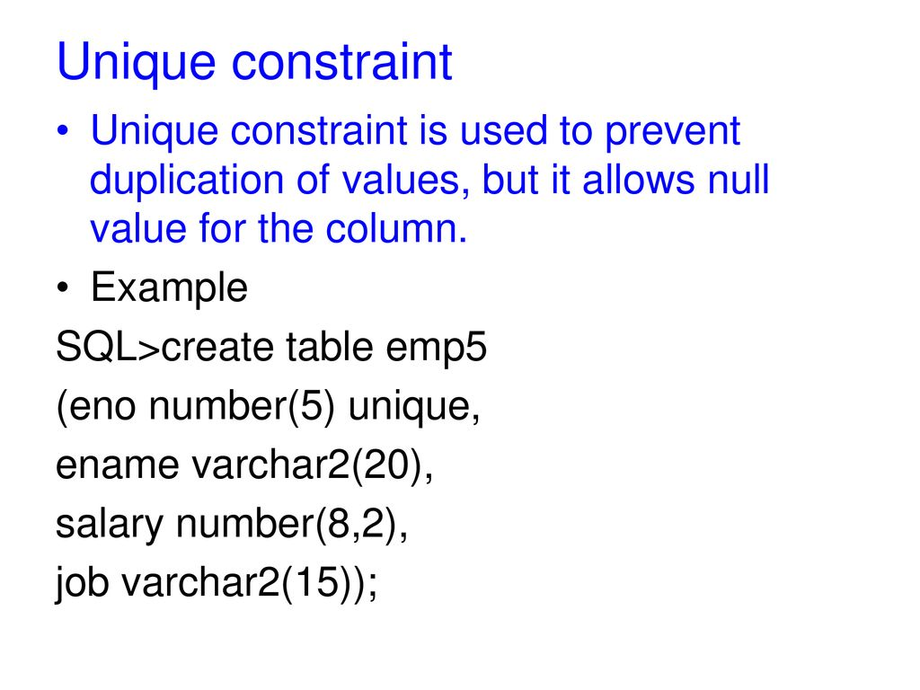

Slide 13
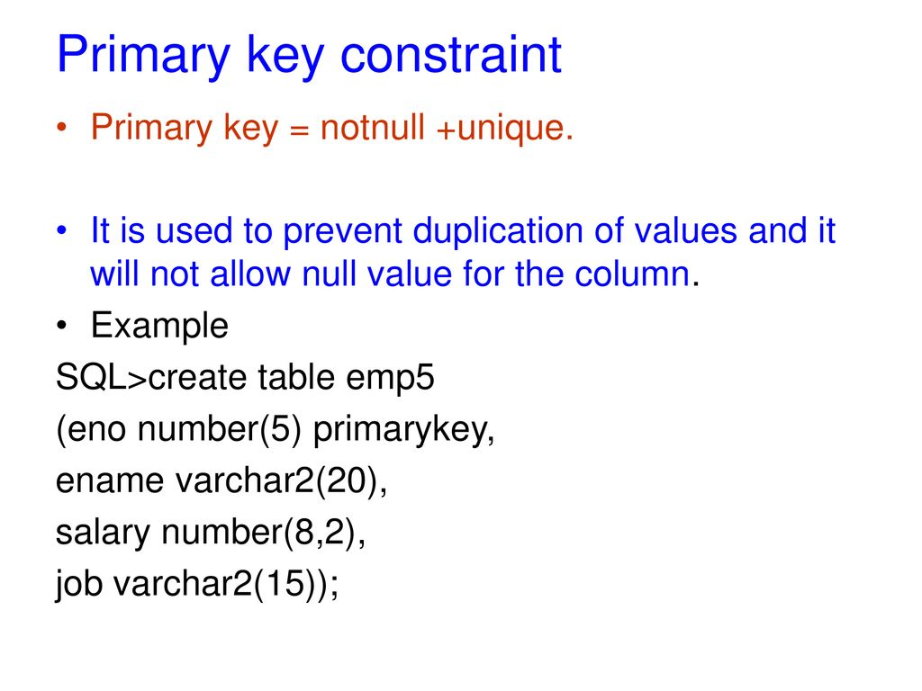

Slide 14
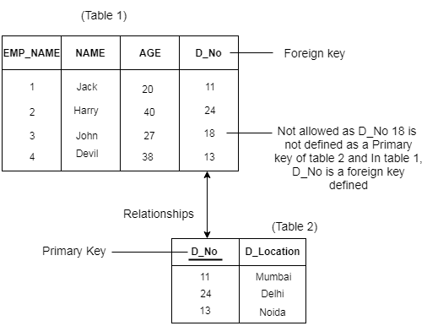
3. Referential Integrity Constraints
A referential integrity constraint is specified between two tables.
In the Referential integrity constraints, if a foreign key in Table 1 refers to the Primary Key of Table 2, then every value of the Foreign Key in Table 1 must be null or be available in Table 2.

Slide 15
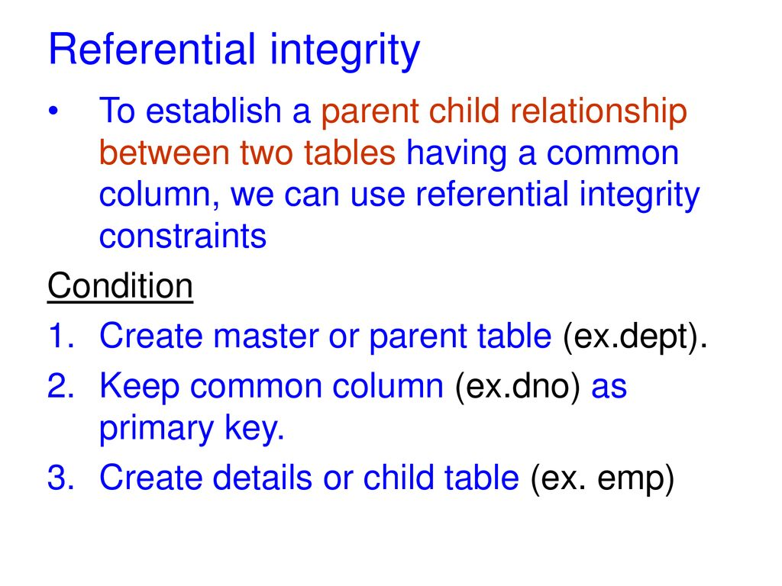

Slide 16
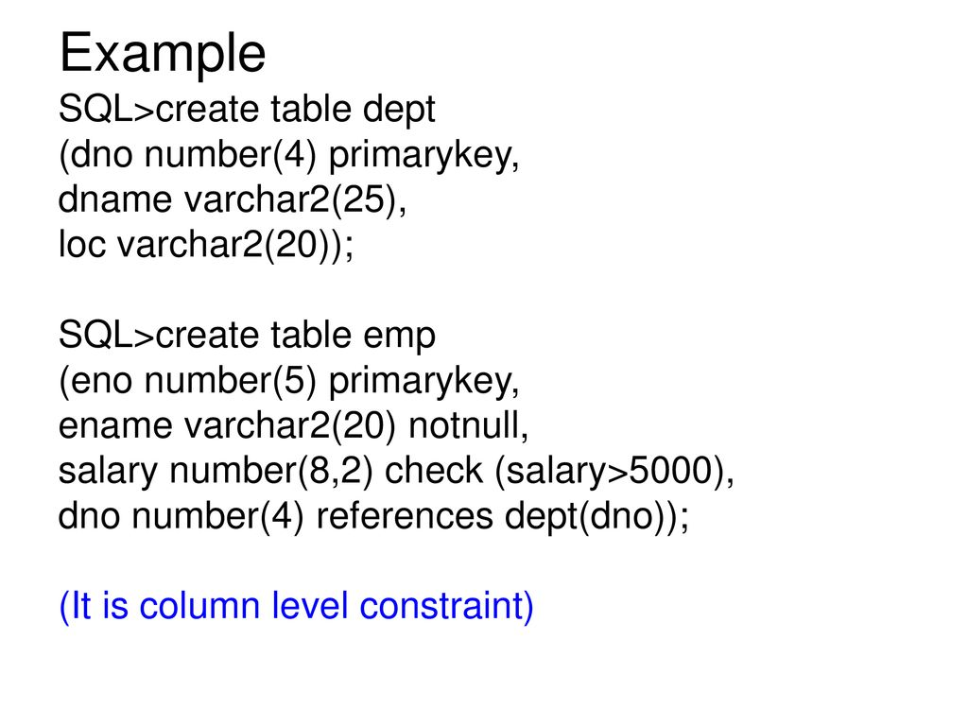

Slide 17
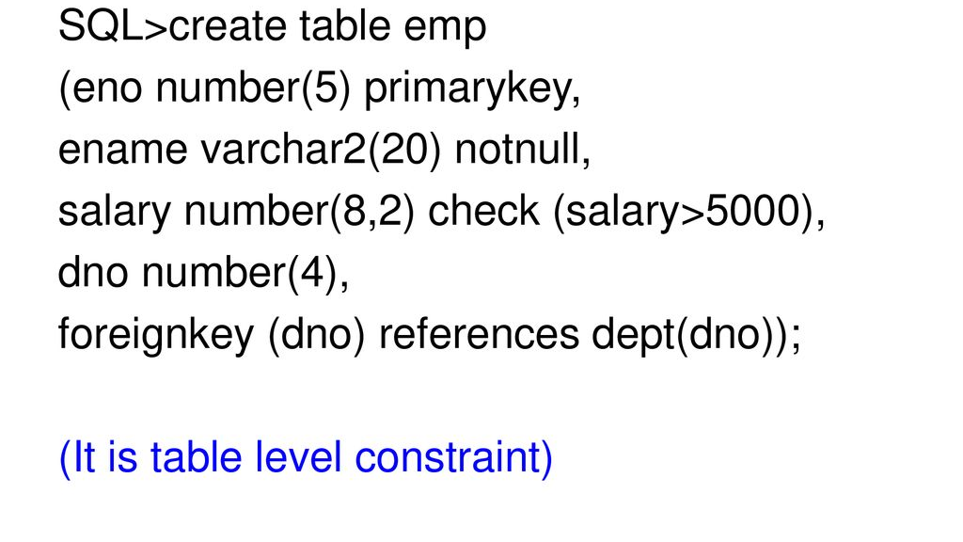

Slide 18
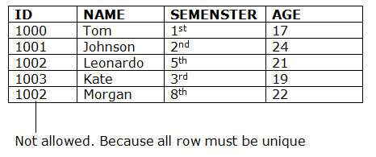
4. Key constraints
Keys are the entity set that is used to identify an entity within its entity set uniquely.
An entity set can have multiple keys, but out of which one key will be the primary key. A primary key can contain a unique and null value in the relational table.

Slide 19
Functional Dependency
The functional dependency is a relationship that exists between two attributes. It typically exists between the primary key and non-key attribute within a table.
X → Y
The left side of FD is known as a determinant, the right side of the production is known as a dependent.

Slide 20
FD
For example:
Assume we have an employee table with attributes: Emp_Id, Emp_Name, Emp_Address.
Here Emp_Id attribute can uniquely identify the Emp_Name attribute of employee table because if we know the Emp_Id, we can tell that employee name associated with it.
Functional dependency can be written as:
Emp_Id → Emp_Name
We can say that Emp_Name is functionally dependent on Emp_Id.

Slide 21
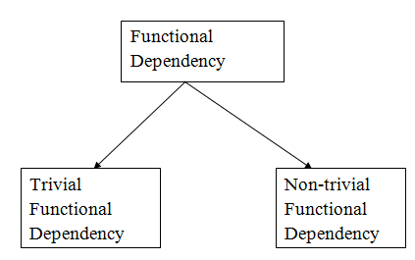
Types of Functional dependency

Slide 22
1. Trivial functional dependency
A → B has trivial functional dependency if B is a subset of A.
The following dependencies are also trivial like:
A → A, B → B
Consider a table with two columns Employee_Id and Employee_Name.
{Employee_id, Employee_Name} → Employee_Id
is a trivial functional dependency as
Employee_Id is a subset of {Employee_Id, Employee_Name}.
Also, Employee_Id → Employee_Id and Employee_Name → Employee_Name are trivial dependencies too.

Slide 23
2. Non-trivial functional dependency
A → B has a non-trivial functional dependency if B is not a subset of A.
When A intersection B is NULL, then A → B is called as complete non-trivial.
Example:
ID → Name,
Name → DOB

Slide 24
Index in SQL
Indexes are special lookup tables that need to be used by the database search engine to speed up data retrieval.
An index is simply a reference to data in a table.
A database index is similar to the index in the back of a journal.
It cannot be viewed by the users and just used to speed up the database access.
Indexes prevent duplicate entries in the column or combination of columns on which it is created.
Since SQL indexes are primarily a performance tool, they are most useful when a database grows in size.
The clustered index is one of the most popular types of indexes supported by SQL server. This type of index is automatically created with a primary key.

Slide 25
Index Definition in SQL
The following reasons makes the use of Index ss necessary in SQL:
SQL Indices can search the information of the large database quickly.
This concept is a quick process for those columns, including different values.
sorts the data values of columns (fields) either in ascending or descending order. And then, it assigns the entry for each value.
Each Index table contains only two columns. The first column is row_id, and the other is indexed-column.
When indicess are used with smaller tables, the performance of the index may not be recognized.

Slide 26
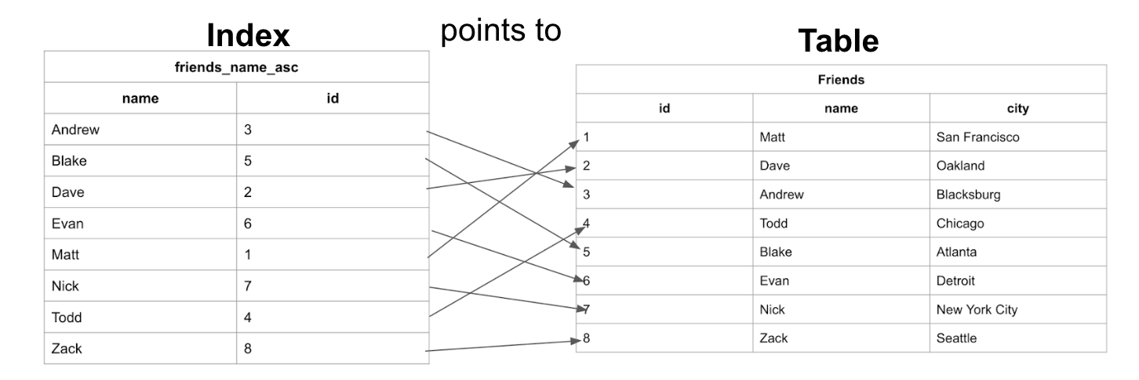

Slide 27
Create an INDEX
In SQL, we can easily create the Index using the following CREATE Statement:
CREATE INDEX Index_Name ON Table_Name ( Column_Name);
Here, Index_Name is the name of that index that we want to create, and Table_Name is the name of the table on which the index is to be created. The Column_Name represents the name of the column on which index is to be applied.

Slide 28
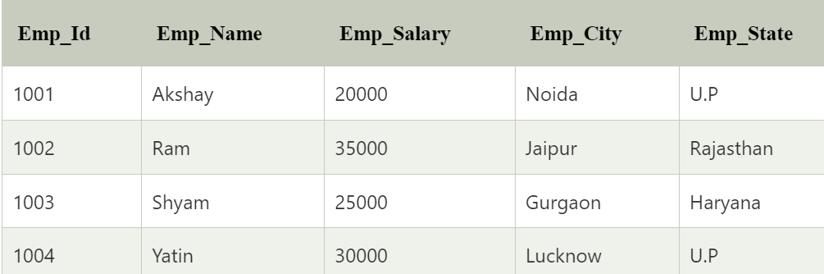
create an index on the combination of two or more columns
syntax
CREATE INDEX Index_Name ON Table_Name ( column_name1, column_name2, ...., column_nameN);

Slide 29
Index on combination of columns
The following SQL query creates an Index 'Index_state' on the Emp_State column of the Employee table.
CREATE INDEX index_state ON Employee (Emp_State);
Suppose we want to create an index on the combination of the Emp_city and the Emp_State column of the above Employee table. For this, we have to use the following query:
CREATE INDEX index_city_State ON Employee (Emp_City, Emp_State);

Slide 30
Create UNIQUE INDEX
Unique Index is the same as the Primary key in SQL. The unique index does not allow selecting those columns which contain duplicate values.
This index is the best way to maintain the data integrity of the SQL tables.
Syntax for creating the Unique Index is as follows:
CREATE UNIQUE INDEX Index_Name ON Table_Name ( Column_Name);
Example:
CREATE UNIQUE INDEX index_salary ON Employee (Emp_Salary);

Slide 31
Rename an INDEX(using ALTER cmd)
ALTER INDEX old_Index_Name RENAME TO new_Index_Name;
Example for Renaming the Index in SQL:
The following SQL query renames the index 'index_Salary' to 'index_Employee_Salary' of the Employee table:
ALTER INDEX index_Salary RENAME TO index_Employee_Salary;

Slide 32
Remove an INDEX
An Index of the table can be easily removed from the SQL database using the DROP command. If you want to delete an index from the data dictionary, you must be the owner of the database or have the privileges for removing it.
Syntax (In Oracle database)
DROP INDEX Index_Name;
Syntax (In MySQL database)
ALTER TABLE Table_Name DROP INDEX Index_Name;
In Ms-Access database:
DROP INDEX Index_Name ON Table_Name;
In SQL Server Database:
DROP INDEX Table_Name.Index_Name;

Slide 33
Alter an INDEX
An index of the table can be easily modified in the relational database using the ALTER command.
The basic syntax for modifying the Index in SQL is as follows:
ALTER INDEX Index_Name ON Table_Name REBUILD;

Slide 34
When Should Indexes Be Avoided
On small tables
Tables that receive a lot of big batch updates or inserts
Columns that have large numbers of null values
Columns that are frequently manipulated
Where columns are manipulated regularly.
When the attribute or field is updated frequently
The attributes aren't often used as a query state

